Slide 1
Beyond Science and Decisions: From Problem Formulation to Dose-Response - Framework

Slide 2
Workshop Objectives
Additionally develop the content of the NAS (2009) report on improving the risk assessment process to develop a compendium of practical, problem-driven approaches for “fit for purpose” risk assessments
linking methods with specific problem formulations (e.g., prioritization, screening, and in-depth assessment) for use by risk managers at a variety of levels (e.g., states, regional managers, people in a variety of agencies, and in the private sector)
Implement a multi-stakeholder approach to share information, ideas and techniques in support of developing practical problem-driven risk assessment methods compendium.

Slide 3
Case Study Process
Process encouraged engagement from wide variety of stakeholders
Proposed in brainstorming prior to first workshop
Initial vetting and review in breakout groups at first workshop
Presentations at second workshop
Additional case studies and issues identified at second workshop
30+ case studies proposed
24 case studies presented and reviewed by panel

Slide 4
Case Study Process & Dose-Response Framework
Need for systematic organization of methods and ability to identify gaps
Need for framework as a resource for risk assessors
An interactive tool – draft framework - was developed by panel members and interested workshop participants to aid in selecting dose-response methods based on:
Problem formulation; data availability; regulatory context
The framework was used by the panel to prioritize new case studies for third workshop, focusing on 3 topic areas:
Problem formulation
Mode of action
Endogenous & background exposures

Slide 5
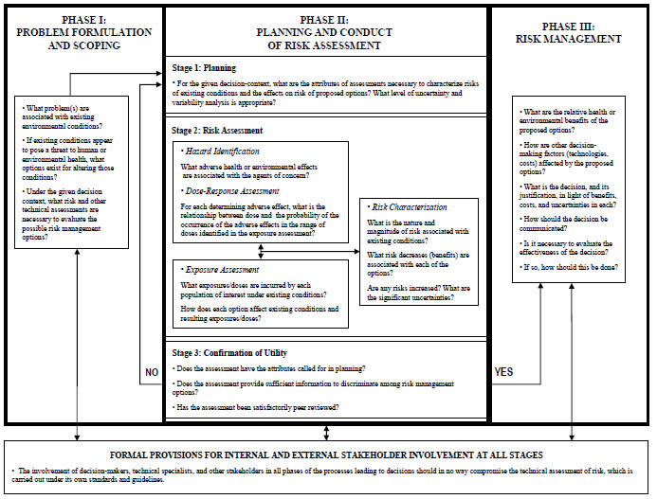
Figure S-1 from NAS (2009) Science and Decisions: Advancing Risk Assessment.
Figure S-1 from NAS (2009) Science and Decisions: Advancing Risk Assessment.

Slide 6
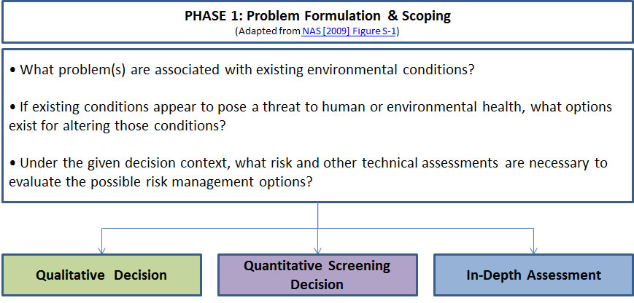
Dose-Response Framework
Notes:
See NAS (2009) Figure S-1, page 10.

Slide 7
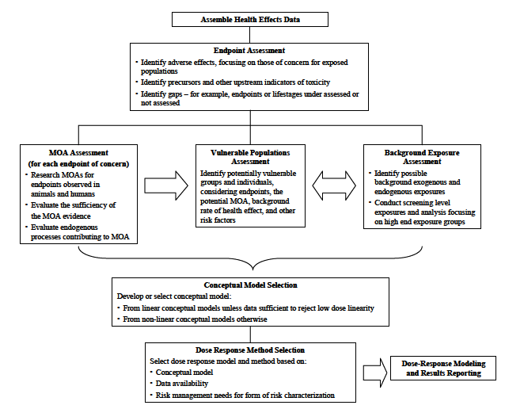
Figure 5-8 from (NAS 2009)

Slide 8
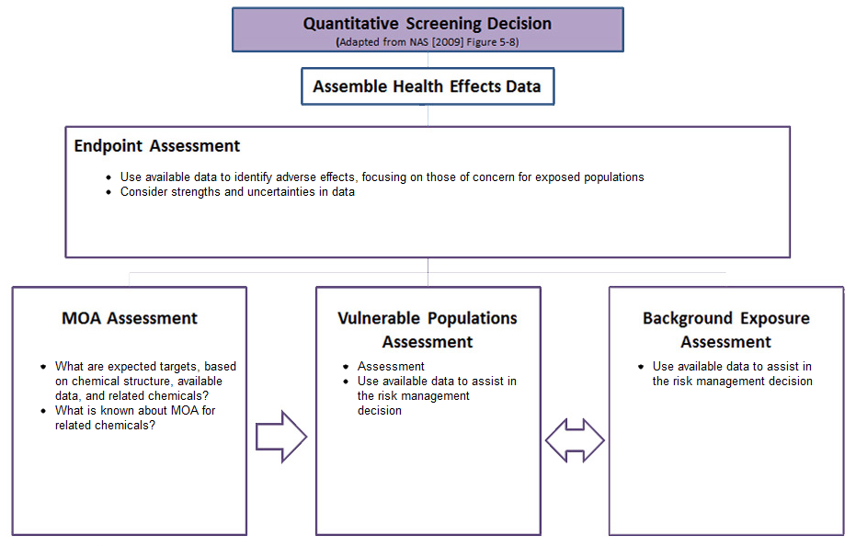

Slide 9
Dose Response Framework
The risk assessor is guided to methods that address key issues, such as:
Mode of action assessment
Vulnerable population assessment
Endogenous/background exposure
Dose-response methods reflecting different
Conceptual models
Data availability
Risk management needs

Slide 10
Methods Presentation
Methods linked to case studies to illustrate real-world application
Summaries that briefly describe method, provide key references, outline the minimum data requirements, describe strengths and weaknesses
Summary addresses the method’s potential to address human variability, sensitive populations, and background exposures or responses.
In depth full case study
Workshop presentation slides
Future: Linking to key guidance documents

Slide 11
Quantitative Screening Methods
Tiered approach case study (includes threshold of concern approach )
Low-dose Extrapolation from BMD(L)
Threshold of toxicological concern
Threshold of regulation
Screening-level safe dose
Structure-activity relationships and read-across
Quantitative SAR

Slide 12
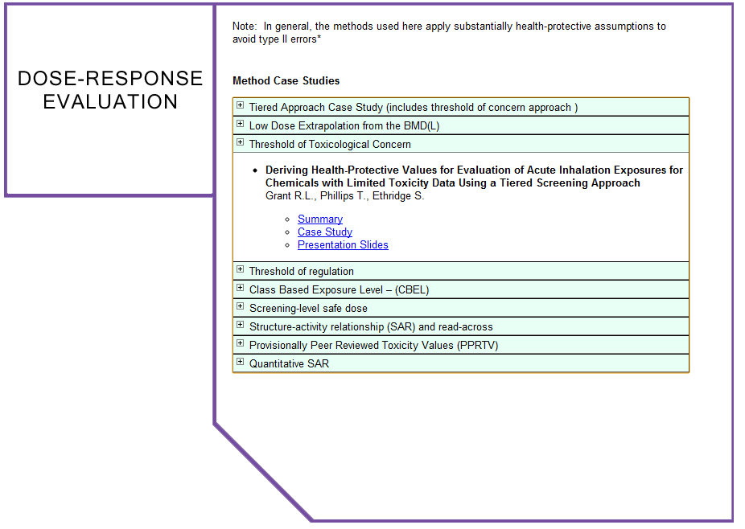

Slide 13
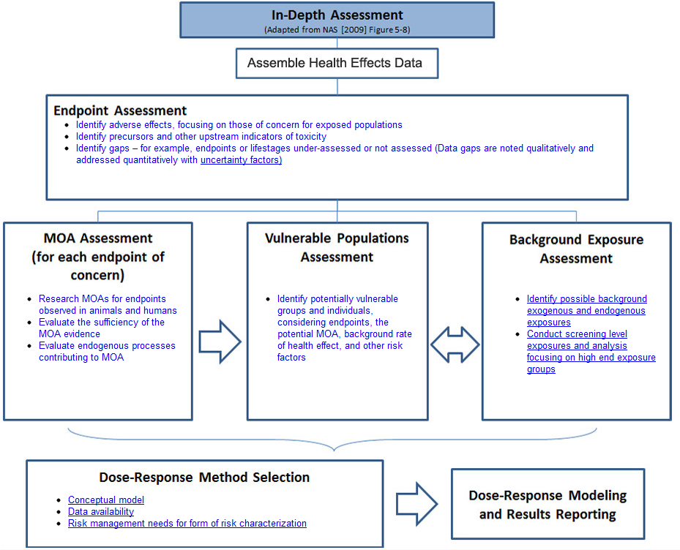
In-Depth Dose-Response Assessment
Notes:
Based on NAS (2009) Figure 5-8 (page 133)

Slide 15
Workshop Results
24 case studies were developed by outside parties and reviewed by the expert panel.
Additionally evolved methodologies in specific areas
Explored crosscutting issues raised by NAS (2009), including---but not limited to---problem formulation, Mode of Action (MOA), background & endogenous exposures, & dose response methods
Paper on workshop series and framework in preparation
Notes:
Workshop Background & Purpose
This workshop series is a continuation of the discussion set forth by the National Academy of Science (2009) Science and Decisions: Advancement of Risk Assessment, toward a unified approach to dose response assessment. Conducted under the aegis of the Alliance for Risk Assessment (ARA), a series of three workshops is underway. The workshops will be lead by an Expert Panel, and will focus on biological and statistical issues that relate to dose-response assessment. Evaluation of dose-response assessment techniques will be based on case studies. The first workshop was devoted to brainstorming and selection of case studies to evaluate proposed dose-response assessment techniques and utility in different problem formulations. In the second workshop, the Expert Panel will lead a discussion and evaluation of case study results. A third workshop scheduled for March of 2011 will seek consensus on a guidance document highlighting key considerations for applying dose-response techniques for common risk assessment applications.

Slide 16
Workshop Results
The expert panel determined that:
A wide range of problem formulations or decision contexts exist for which different dose-response analysis techniques are needed.
It is important for risk assessors to explain criteria applied in the choice of a particular dose-response or risk assessment approach, and how the dose-response results will be used in a risk management decision.
Additional dissemination of dose-response analysis techniques for a wide range of problem formulations or decision contexts is needed
Additional case studies would be useful on topics such as:
Combined exposures
Value of information
Illustrating an entire risk assessment, from problem formulation to conclusion
In vitro to in vivo extrapolation
Notes:
Workshop Background & Purpose
This workshop series is a continuation of the discussion set forth by the National Academy of Science (2009) Science and Decisions: Advancement of Risk Assessment, toward a unified approach to dose response assessment. Conducted under the aegis of the Alliance for Risk Assessment (ARA), a series of three workshops is underway. The workshops will be lead by an Expert Panel, and will focus on biological and statistical issues that relate to dose-response assessment. Evaluation of dose-response assessment techniques will be based on case studies. The first workshop was devoted to brainstorming and selection of case studies to evaluate proposed dose-response assessment techniques and utility in different problem formulations. In the second workshop, the Expert Panel will lead a discussion and evaluation of case study results. A third workshop scheduled for March of 2011 will seek consensus on a guidance document highlighting key considerations for applying dose-response techniques for common risk assessment applications.

Slide 17
Next Steps
Framework will be “evergreen,” growing and evolving over time. It will be updated with additional methods and guidance documents, illustrated by case studies and with papers addressing and resolving cross-cutting issues.
The National Library of Medicine has expressed interest in hosting the Framework.
A standing panel has been created to meet twice a year to review additional case studies and issue/resolution papers.
Workshop 4 scheduled for May 22-24 in Austin, Texas at TCEQ. Additional sponsors/participants will be invited to join in the overall effort.

Slide 18
Collaborators
Notes:
48 sponsors includes 12 government agencies, 12 industry groups, 7 scientific societies, 9 non-profit organizations/consortia, and 8 CONSULTING GROUPS: Academy of Toxicological Sciences
Agency for Toxic Substances and Disease Registry
American Chemistry Council
American Petroleum Institute
American Water Works Association
Center for Food Safety and Applied Nutrition (US Food and Drug Administration)
CONSORTIUM FOR ENVIRONMENTAL RISK MANAGEMENT, LLC (CERM)
CropLife America
Dose Response Specialty Group (Society for Risk Analysis)
Electric Power Research Institute
ENVIRON
Ethylene Oxide Panel of the ACC
Georgia Department of Natural Resources (EPD)
Georgia Pacific
GRADIENT
Hamner Institutes
Hawai’i Department of Health (HEER)
Human Toxicology Project Consortium
Illinois Environmental Protection Agency
Indiana Department of Environmental Management
INDUSTRIAL ECONOMICS, INCORPORATED
International Copper Association
International Society of Regulatory Toxicology and Pharmacology
The LifeLine Group
Mickey Leland National Urban Air Toxics Research Center
Minnesota Pollution Control Agency (Environmental Analysis & Outcomes Division)
Naphthalene Council
National Center for Toxicological Research
New Zealand Ministry of Health
Nickel Producers Environmental Research Association
Noblis
NSF International
Ohio Environmental Protection Agency
PASTOR, BEHLING & WHEELER, LLC
Regulatory and Safety Evaluation Specialty Section (Society of Toxicology)
Risk Assessment Specialty Section (Society of Toxicology)
SAPPHIRE GROUP
SC Johnson & Son
Society for Risk Analysis
Society of Toxicology
SUMMIT TOXICOLOGY
TED SIMON, LLC
Texas Association of Business
Texas Chemical Council
Texas Commission on Environmental Quality
Texas Industry Project
Toxicology Excellence for Risk Assessment
U.S. Environmental Protection Agency
With financial support from Health Canada

Slide 19
Framework
ARA Dose Response Framework – (working beta) http://www.allianceforrisk.org/workshop/framework/ problemformulation.html
Monday, 9:30-12:15: Poster Board -415. Where the rubber meets the road: A practical methods compendium for risk assessors.
Workshop 4 scheduled for May 22-24 in Austin, Texas at TCEQ

